Slide 1
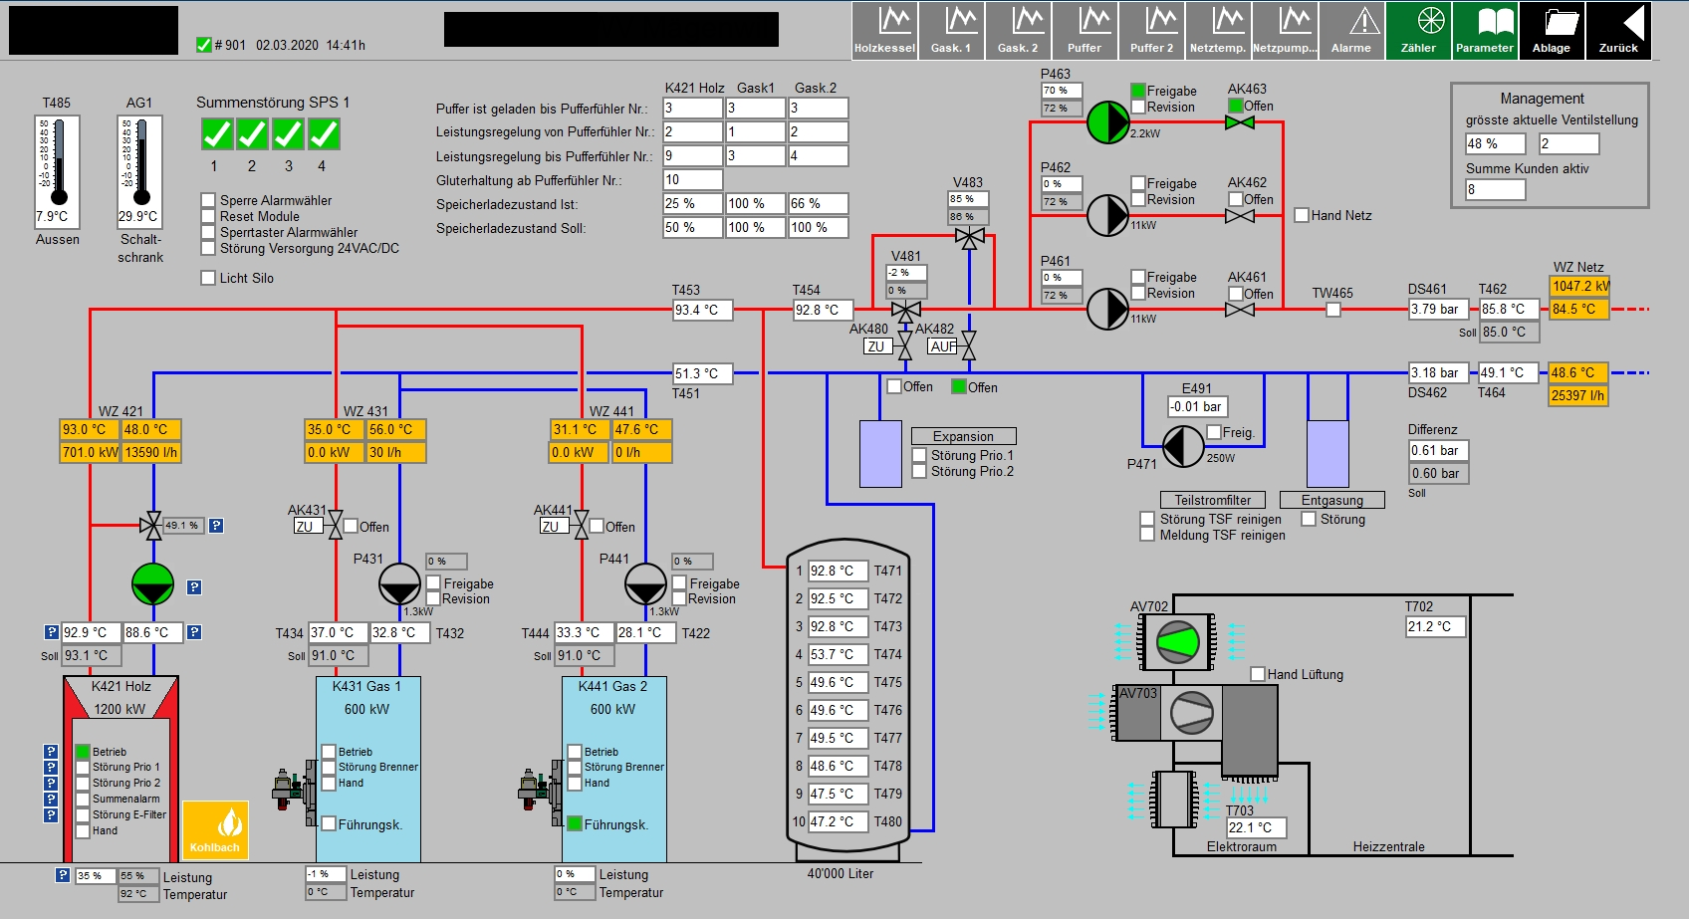
01 Optimization of District Heating
1901_protWZ.csv
2901_protWZ.csv
3901_protWZ.csv
4901_protWZ.csv

Slide 2
1901_protWZ.csv
2901_protWZ.csv
3901_protWZ.csv
4901_protWZ.csv
Biomass
Peak
Peak
Storage

Slide 3

Challenge
Decrease gas peak boiler runtime due to better storage operation
3. better storage operation 2. improved storage control 1. heat demand forecast
Biomass
Gas peak
Gas peak
Storage

Slide 4

District Heating Network
901_protSPS.csv Heat station (store, pumps, etc.)
2901_protWZ.csv Wood-fired boiler
3901_protWZ.csv Gas-fired boiler 1
4901_protWZ.csv Gas-fired boiler 2
Heat
Station
8
350 kW (07/2018)
8_prot.csv
9
60 kW (10/2018)
9_prot.csv
850 kW
1006_protWZ.csv
6_protSPS.csv¹
6
30 kW (01/2018)
7_prot.csv
7
1
650 kW
1_prot.csv
2
90 kW
2_prot.csv
3
160 kW
3_prot.csv
4
60 kW
4_prot.csv
Legend:
X
<nominal power> (<date of connection>)
<data file>
5
100 kW
5_prot.csv

Slide 5
District Heating Network
Lastprofil alle
Heat
Station
8
9
6
7
Lastprofil Verbraucher 1
1
Lastprofil Verbraucher 2
2
3
4
5

Slide 6
Correlation ambient temperature
For daily forecasts the ambient temperature maybe important or not

Slide 7
Correlation other independent parameters
The weekday may be important or not

Slide 8
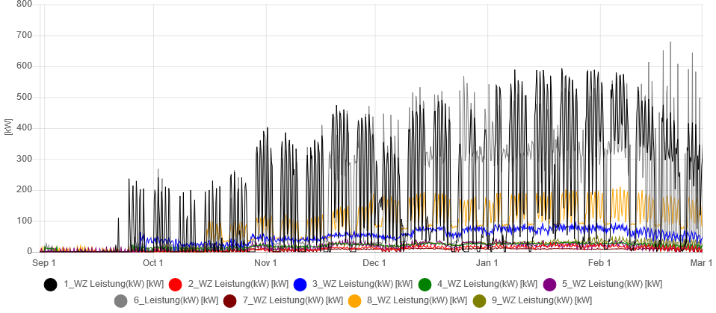
Main consumers
2/4 von 10 dominate the heat required!

Slide 9
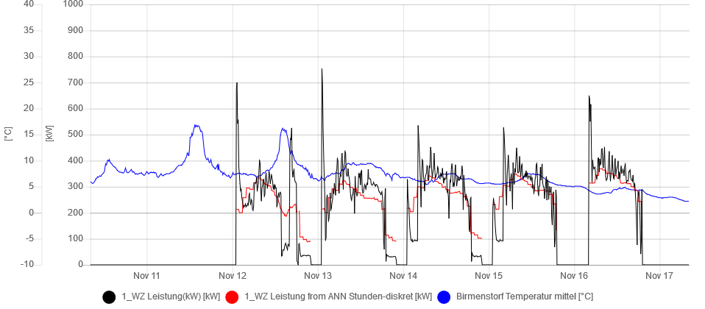
Main consumer 1 correlation: AI forecast algorithm

Slide 10
Further proceeding
Finalize forecast algorithm
Develop concept for new control settings
Set point biomass boiler + set point storage vessel
New control settings implementation
Simulation with existing data: do settings make sense?
New main control settings manually
New main control settings auto
Transfer to other CH district heating systems

Slide 11
01 Optimization of District Heating
Team
Andy Gubser
Emilie Boillat (remote)
Martin Horeni
Marvin Grass
Toni Wietlisbach (AEW, owner)
Wolfram Willuhn

